Slide 1
Filamin-A
01 / 08
Notes:
SAY
Filamin-A connects the structure of a cell with the forces acting on it. I will explain how its molecular structure makes that possible, and why this matters in medicine.
It is a polypeptide protein, about 280 kDa per chain.
- Organises actin microfilaments into networks.
- 2,647 amino acids per chain. This is the canonical human sequence.
- An N-terminal actin-binding domain plus 24 immunoglobulin-like repeats. These occur in each chain.
- Normally functions as a homodimer. Two identical Filamin-A chains join together.

Slide 2
OVERVIEW
A flexible link inside cells
Two actin-binding ends
Actin-binding ends
Connect different actin filaments
Actin
Actin
24 folded repeats per chain
Provide surfaces for binding partners
Flexible hinges
Flexible hinges
Let the network change shape
Repeat 24 joins the chains
A connected network that can deform without becoming rigid.
02 / 08
Notes:
SAY
Filamin-A is an intracellular actin-binding protein. Actin forms filaments in the cytoskeleton. Filamin-A cross-links these filaments into a network that supports the cell while allowing it to change shape.
Its structure explains this function. Two identical polypeptide chains form a flexible, V-shaped homodimer. Each chain is about 280 kilodaltons and contains an actin-binding region followed by 24 immunoglobulin-like repeats. The last repeat joins the two chains.
With an actin-binding region at each end of the V, one molecule can connect two different filaments. Flexible hinge regions let the arms change their relative orientation. This helps form a branching network rather than only parallel bundles: the cell gains support, but the network can still deform.
So both the number of binding ends and their arrangement matter. Filamin-A is not an ATP-driven motor like myosin: it organises the network through protein binding.
UNDERSTAND / NOT TIMED
From a chain of amino acids to a cross-link
Read the diagram
One arm = one polypeptide: The V is a schematic of two long chains, not a photograph or a rigid shape. Each chain has 2,647 amino-acid residues in the canonical human sequence.
Outer ends = actin-binding regions: Each end can associate with an existing actin filament. Filamin-A does not turn into actin and does not join the filaments by making peptide bonds between them.
Arms = folded repeats and flexible connections: Each chain contains 24 compact immunoglobulin-like domains. Flexible hinges lie between repeats 15 and 16, and between repeats 23 and 24. They permit changes in the angle and arrangement of the arms.
Meeting point = dimerisation: Repeat 24 on one chain associates with repeat 24 on the other. Two approximately 280-kDa subunits give a homodimer of approximately 560 kDa.
Why this architecture is useful
Two attachment points: A cross-link needs to engage separate filaments. Dimerisation brings two actin-binding ends into the same molecule, creating that bridging arrangement.
A branching network: The arms can engage differently oriented filaments. Many such connections help form a three-dimensional network rather than simply a bundle of parallel filaments.
Support with flexibility: The hinges provide flexible connections between folded regions. A network can change its geometry under load while retaining many of its connections. Flexibility does not mean the protein provides no support.
Where in the cell?
Filamin-A is found in the cytoplasm, including the actin-rich cortex just beneath the plasma membrane. This is a useful position for linking membrane-associated proteins to the internal actin network.
Actin versus myosin versus Filamin-A
Actin supplies the filaments. Myosin uses ATP to generate force by interacting with actin. Filamin-A connects filaments and other proteins, helping the network transmit and respond to force. These are complementary jobs, not three names for the same protein.
JUST IN CASE
Is Filamin-A fibrous or globular? It is an elongated cytoskeletal cross-linker built from compact folded domains. Describing it only as a compact globular protein misses its architecture; describing it as a collagen-like extracellular fibre is also misleading.
Is it the only filamin? No. Humans also have Filamin-B and Filamin-C. This presentation concerns Filamin-A, encoded by FLNA; findings about the other isoforms should not automatically be assigned to it.
Why two chains? Dimerisation produces two actin-binding ends. This enables cross-linking rather than just attachment to one filament.

Slide 3
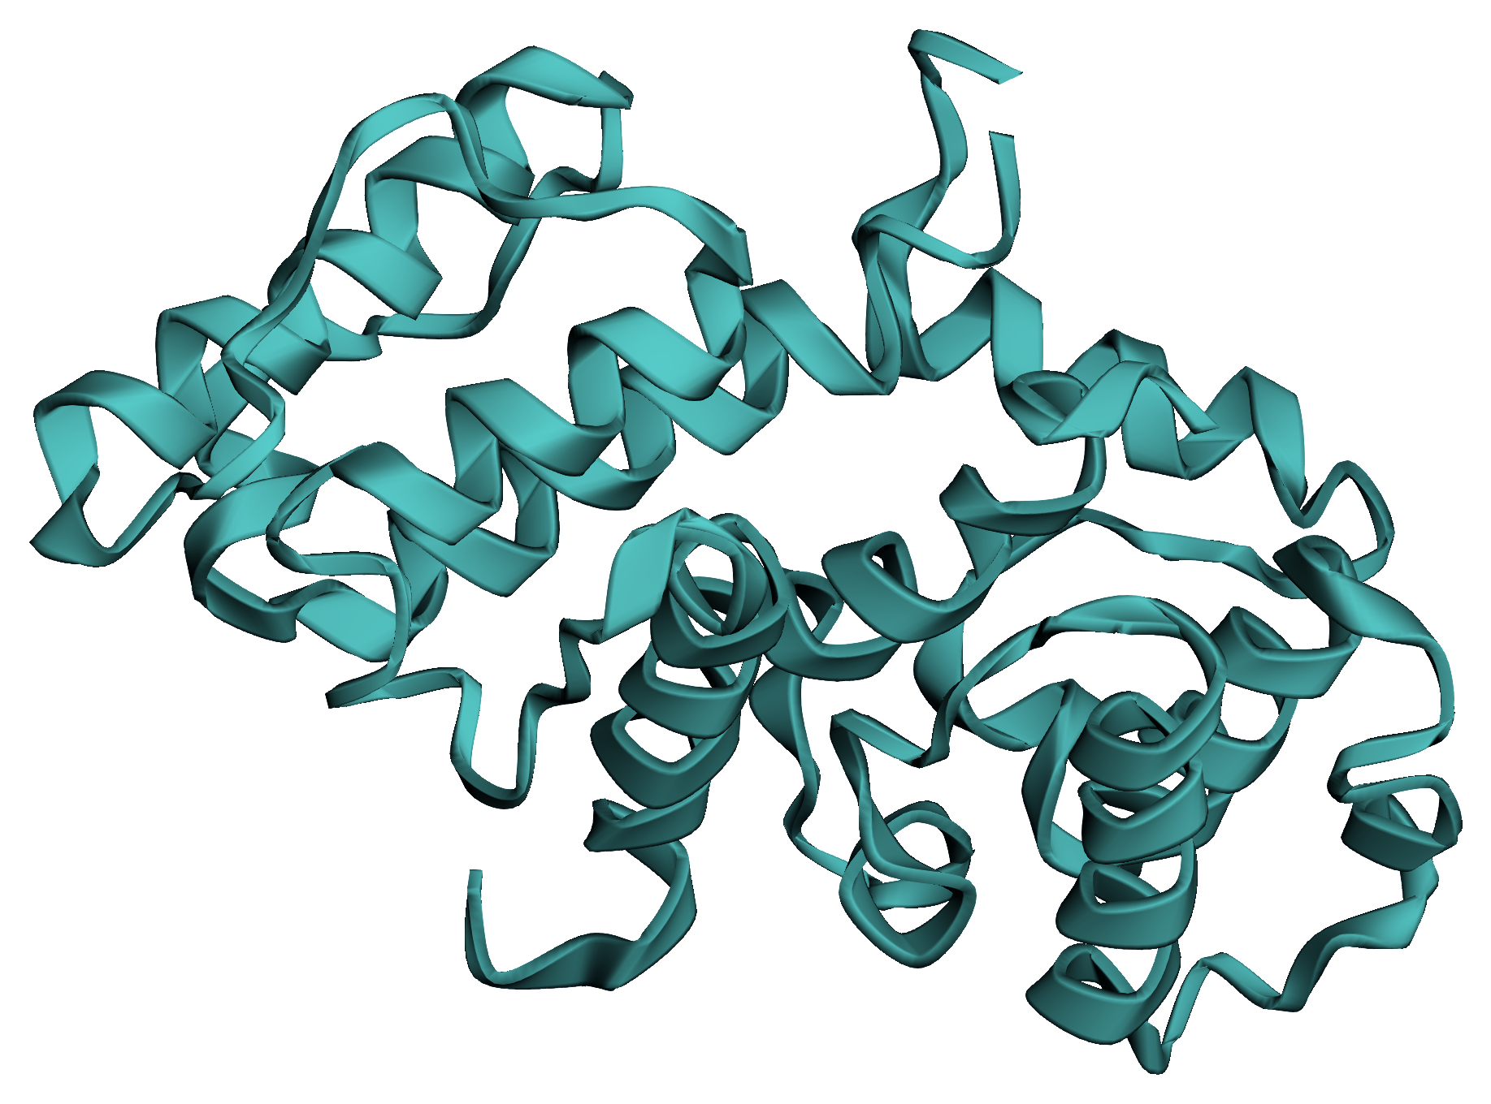
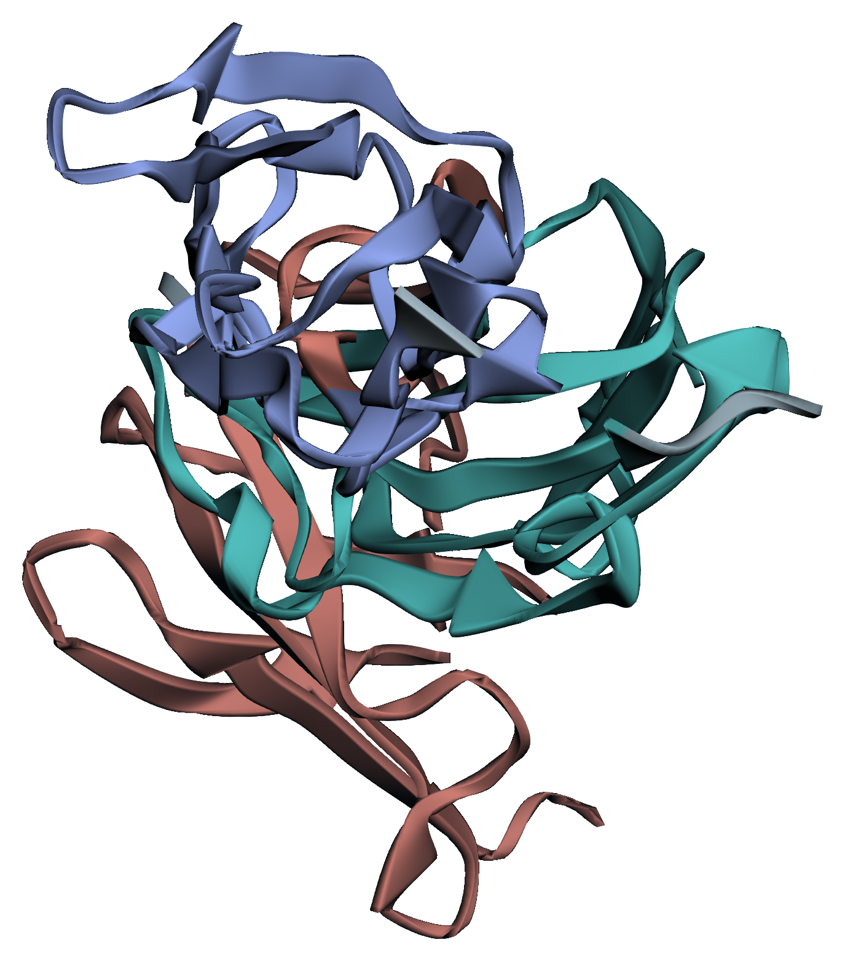
MOLECULAR VIEW
What the folded protein looks like
Actin-binding fragment
Domains 19-21 (fragment)
Domain 19
Domain 21
Domain 20
Alpha-helix-rich
Beta-sheet-rich
Folding positions chemical groups for selective, reversible binding.
03 / 08
Notes:
SAY
These are structures of experimentally studied fragments, not a complete model of the enormous protein. On the left is its actin-binding region, with prominent alpha helices. On the right are three repeated domains, built mainly from beta sheets: domain 19 in blue, 20 in coral and 21 in teal.
Immunoglobulin-like describes the fold; it does not mean Filamin-A is an antibody. Folding positions amino-acid side chains to create surfaces with particular shapes and charges. A suitable partner can bind through several noncovalent interactions, making the association selective but reversible.
The key is not simply having helices or sheets. It is how the sequence and fold arrange the binding surface. That is our structure-function relationship at the molecular level.
UNDERSTAND / NOT TIMED
How to read a protein ribbon
What the ribbons represent
A ribbon follows the folded protein backbone. Coiled ribbons show alpha helices, broad arrows show beta strands, and thin connections show intervening loops. Side chains and most individual atoms are omitted so the fold is readable.
Left: the actin-binding region
This isolated fragment contains two calponin-homology domains. Their arrangement helps create the actin-binding interface. Actin itself is not present in this image. The green colour identifies the fragment; it is not the natural colour of a protein.
Right: a small part of an arm
This fragment contains repeats 19, 20 and 21, not all 24 repeats. Blue identifies domain 19, coral domain 20 and teal domain 21. The colours separate regions of this one chain; they do not represent the two arms of the dimer. The same coral/teal distinction continues on the next slide, and domain 21 remains teal in the platelet example.
The four levels of structure
Primary: The amino-acid sequence, joined by covalent peptide bonds.
Secondary: Local alpha helices and beta sheets, stabilised largely by hydrogen bonds between backbone groups.
Tertiary: The three-dimensional arrangement of a single chain, including its domains and binding surfaces.
Quaternary: The association of the two Filamin-A chains into the functional homodimer.
Why a ligand fits
A binding site is a surface with a suitable shape and chemical groups. Hydrogen bonds, electrostatic interactions, hydrophobic contacts and van der Waals interactions can stabilise binding. The interaction can be reversible without being weak or unimportant.
JUST IN CASE
Are these photographs? No. They are ribbon renderings of experimentally determined atomic coordinates. The colours and viewing angle were chosen for clarity. They are not imagined molecular structures.
Does immunoglobulin-like mean immune function? No. A similar domain fold can serve different purposes. Here it provides a structural unit and binding surfaces; it is not an antigen-specific antibody.
What if a residue changes? A substitution can change local charge, packing, stability or binding. The whole fold need not collapse for function to change. Some substitutions have little functional effect.

Slide 4
MECHANISM
Support that can sense force
Partly masked
Under tension
Domain 21
20
21
20
21
Domain 20
Domain 21
Domain 20
Binding site covered
Partner can bind
Domain 20 partly covers domain 21's binding site.
Mechanical force changes molecular binding: mechanotransduction.
04 / 08
Notes:
SAY
First, Filamin-A links the cell membrane to the actin cytoskeleton. Integrins sit in the membrane, and Filamin-A can connect them to actin. This creates a path for mechanical force to travel through the cell.
1. Then force changes Filamin-A’s shape. In one well-studied region, repeat 20 partly covers a binding site on repeat 21.
2. When Filamin-A is pulled, this site becomes more exposed. The amino-acid sequence stays the same, but the protein changes conformation.
3. Now another protein can bind to that exposed site. So a mechanical input — force — causes a biochemical change — new protein binding.
This is called mechanotransduction. Filamin-A is therefore not only a structural cross-linker, but also a force-sensitive scaffold.
UNDERSTAND / NOT TIMED
Follow the force, then the binding change
Outside to inside
Attachment: An integrin spans the plasma membrane. Its extracellular region binds material outside the cell; its cytoplasmic tail can interact with intracellular proteins.
Mechanical connection: Filamin-A can connect receptor-associated complexes to actin. Pulling on the attachment, or myosin-generated tension inside the cell, can load this connection.
Structural response: In the repeat 20-21 pair, part of repeat 20 can mask a ligand-binding surface on repeat 21. Force can favour a more open, accessible arrangement.
Biochemical consequence: A partner that can reach the exposed site may bind more readily. A physical input has changed a molecular interaction.
What actually moves?
Protein segments shift relative to each other; some local unfolding may occur under force. A ligand also moves through the cytoplasm and can associate with an accessible site. Filamin-A is not sending a tiny object along its arm to carry a message.
Not all stretching is the same
The gate is an analogy for accessibility, not an all-or-nothing switch. Force can shift how often a site is accessible. The diagram simplifies a particular domain arrangement; it does not mean that every Filamin-A site is normally hidden, that every ligand binds more strongly under tension, or that unlimited force is beneficial.
Scaffold versus enzyme
A scaffold organises binding partners in space. An enzyme catalyses a chemical reaction. Filamin-A's central role here is scaffolding and mechanical regulation, rather than catalysis or ATP hydrolysis.
JUST IN CASE
Does Filamin-A use ATP to pull? Not as a motor in this mechanism. Myosin can supply force; Filamin-A binds, transmits force and changes the accessibility of some binding sites.
Is force-induced opening denaturation? It may involve local rearrangement or partial unfolding rather than complete loss of the entire protein's structure. Reversible regulation is different from indiscriminate damaging denaturation.
Does Filamin-A go to DNA to relay this force? That is not what the slide shows. A changed binding interaction can influence downstream signalling. Filamin-A is not presented here as a transcription factor.

Slide 5
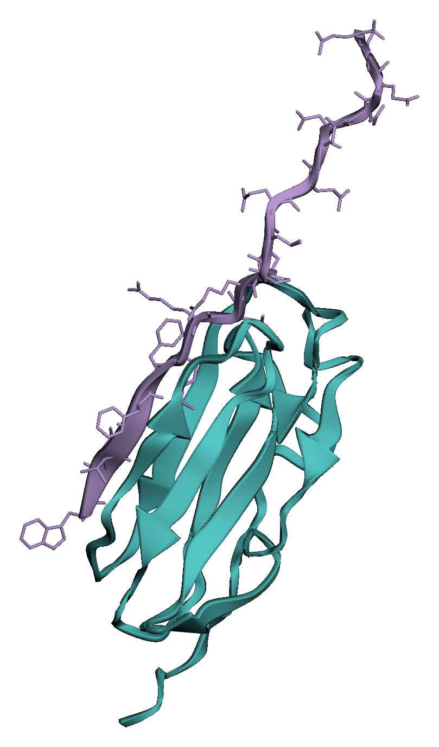
PHYSIOLOGY
A working example: platelets
In a platelet
Filamin-A
Attachment
Actin network
Domain 21 of 24
Integrin
Binding interface
Integrin tail
Intracellular fragment
Filamin-A
Membrane
Separate binding sites connect the receptor to actin.
05 / 08
Notes:
SAY
Filamin-A also supports platelet production: in experimental mice lacking it, megakaryocytes release unusually large, fragile platelets too early.
A practical example is a platelet attaching at an injured blood vessel. Its surface receptors attach to the damaged area, and its actin cytoskeleton reorganises as the platelet spreads.
Filamin-A helps connect receptor complexes to that cytoskeleton. Different parts of the molecule can bind the receptor and actin, creating a physical link between them. This allows adhesion, cell shape and mechanical forces to be coordinated during clot formation.
Here, the teal structure is domain 21 of Filamin-A's 24 repeats. The violet segment is the short intracellular tail of a platelet integrin, bound to it. The pointer marks their binding interface; the complete receptor is not shown. This illustrates how a small peptide binds a particular folded surface to connect a membrane receptor to the cell interior.
UNDERSTAND / NOT TIMED
From a vessel injury to a molecular contact
Before the mature platelet: production
Megakaryocytes are large bone-marrow cells that produce platelets. In Begonja and colleagues' experimental mouse model, loss of Filamin-A in this cell lineage led to premature release of oversized, mechanically unstable platelets. They fragmented and were removed rapidly by macrophages. This supports a role in platelet formation and survival, as well as mature platelet function; it is not a claim that every human FLNA variant has the same effect.
The physiological sequence
Injury exposes an adhesive surface: Platelets attach through several receptor systems. Adhesion and activation change their shape and promote further platelet recruitment.
The internal network reorganises: Actin assembly and myosin activity help platelets spread and generate contractile force. Filamin-A contributes connections and organisation; it does not perform every step alone.
Receptors communicate with the interior: Integrin alpha-IIb/beta-3 participates in platelet aggregation. Connections involving its cytoplasmic tails help coordinate receptor attachment with the cytoskeleton.
Exactly what is in the image?
Teal is domain 21 of Filamin-A's 24 repeat domains. Violet is an alpha-IIb integrin cytoplasmic-tail fragment bound to it. The pointer marks their contact region, located from the experimental coordinates. This is a local interface, not the entire receptor, an actin filament or a whole platelet. One representative structure from the NMR ensemble is shown.
What it demonstrates, and what it does not
The image demonstrates a binding arrangement. By itself it cannot show a platelet moving, prove how much force it generates, or establish the timing of every signalling step. Integrin regulation also involves other proteins, including talin; Filamin-A is not a universal on-switch.
Two uses of the word protein
Both binding partners are proteins or protein fragments. A ligand does not have to be a small molecule such as oxygen: one protein can be a ligand for another protein's binding surface.
JUST IN CASE
Does Filamin-A have another role in platelets? Yes. It contributes to platelet production from megakaryocytes and to platelet stability. In an experimental mouse study, its absence caused premature release of large, fragile platelets that were cleared rapidly from the circulation. This is separate from its role linking receptors to actin in mature platelets.
Does this alone make a blood clot? No. Platelet receptors, actin, myosin, adhesive proteins and the coagulation system all contribute. Filamin-A is one part of the organisation and mechanical coupling.
Which partner is the ligand? When discussing Filamin-A's site, the integrin-tail peptide is the ligand. The term describes the binding relationship, not a special class of small molecules.

Slide 6
MEDICINE
When Filamin-A changes
FLNA variant
Usual location
Heterotopia
Altered protein function
Cortex
Cortex
Disrupted tissue organisation
Retained neurons
Periventricular nodular
heterotopia
Ventricle
Ventricle
Neurons near the ventricles; possible seizures
Laboratory: Western blot (~280 kDa) | Clinical: MRI + genetic testing
06 / 08
Notes:
SAY
The FLNA gene encodes Filamin-A. Certain loss-of-function variants cause periventricular nodular heterotopia. During brain development, some neurons remain near the ventricles instead of reaching their normal cortical position. Patients may develop seizures.
This shows how altered protein function can affect whole tissues. But a mutation does not always mean less activity. Some variants linked to skeletal disorders actually increase actin binding. A small amino-acid change can alter an interaction without destroying the overall fold: stronger binding is not automatically better function.
In the laboratory, an antibody against Filamin-A can identify it on a Western blot, typically around 280 kilodaltons after the chains are separated. Clinically, brain imaging and genetic testing are more relevant than treating Filamin-A as a routine blood marker.
UNDERSTAND / NOT TIMED
Connect a molecular defect to a clinical finding
A teaching example, not a reported patient
Imagine a person assessed for seizures whose MRI shows nodules of grey matter along the lateral ventricles. One possible explanation is FLNA-related periventricular nodular heterotopia. MRI appearance and symptoms alone do not prove which gene is responsible.
Periventricular nodular heterotopia (PVNH): word by word
Peri- = around or surrounding: This prefix tells you where something is located.
Ventricular = relating to the ventricles: The brain's ventricles are fluid-filled spaces. Together, peri- and ventricular mean around or beside these spaces.
Nodular = forming nodules: Nodules are small rounded lumps or clusters. Here, they are clusters of neurons.
Hetero- = different or other: This is the first part of heterotopia.
-topia = place or location: Heterotopia means tissue in an abnormal location, not necessarily abnormal-looking cells.
Put together
Periventricular nodular heterotopia means small clusters of brain tissue in an abnormal position beside the brain's ventricles.
What happens during brain development?
Normally: During fetal development, many neurons are produced near the ventricles and migrate outward to their places in the cerebral cortex.
In PVNH: Some neurons do not reach their usual cortical position. Instead, they remain as nodules along the walls of the ventricles. This describes the outcome; the underlying developmental mechanisms are more complex.
Memory cue
Peri = around; ventricular = ventricles; nodular = little clusters; heterotopia = wrong place.
Why does a structural protein affect the brain?
Neural development depends on coordinated cell shape, adhesion, tissue integrity and migration. Defective Filamin-A can disrupt these processes. It is too simple to describe it as one broken motor preventing every neuron from walking to its destination.
Different variants, different effects
A loss-of-function variant reduces an important normal activity or the amount of functional protein. Other variants can alter binding or regulation differently, including gain-of-function mechanisms in some skeletal disorders. Not every FLNA variant causes the same disease or is pathogenic.
A concrete sequence-to-function example
In experiments on the isolated actin-binding region, the skeletal-disorder variant E254K increased actin binding even though the overall fold remained similar. E254K means glutamate at residue 254 is replaced by lysine: a negatively charged side chain is replaced by a positively charged one. A local stabilising interaction is lost, illustrating how local chemistry can alter function without a complete structural collapse. The molecular image on slide 3 shows the wild-type fragment, not this variant.
What would the laboratory methods tell us?
SDS-PAGE: Denatured proteins are separated mainly by size. Filamin-A's identical chains run at approximately 280 kDa, not as an intact approximately 560-kDa dimer.
Western blot: Proteins are transferred to a membrane and probed with an antibody. A band helps identify Filamin-A; abundance alone does not prove normal function.
Immunofluorescence: A fluorescent antibody can show where Filamin-A is in cells. Co-localisation with actin suggests proximity, not proof of direct binding.
Clinical assessment: MRI examines the brain's structure; genetic testing examines the FLNA sequence. Neither is the same question as measuring the amount of protein in an experimental cell lysate.
JUST IN CASE
Why one 280-kDa band, not two? The two chains are identical in size and migrate together after dissociation. A single band can contain many molecules of the same chain; it does not mean the intact protein was a monomer.
Can a normal blot exclude a functional defect? No. A variant may leave the protein amount and approximate mass normal while altering binding or regulation. Functional assays and genetic context answer different questions.
Does every patient have seizures? No. Clinical manifestations vary. FLNA-associated disease can involve several organs; this talk uses one recognised example rather than a universal presentation.

Slide 7
RESEARCH / 2026
Sensing an abnormal neighbour
Normal neighbours sense deformation
Gene-regulatory
response
Extrusion from
the cell layer
Normal
Transformed
Normal
Cell-culture evidence, not an established cancer treatment.
07 / 08
Notes:
SAY
A 2026 study suggests another role: helping normal epithelial cells respond to an abnormal neighbour. In a cell-culture model, transformed cells became larger and stretched surrounding normal cells.
Filamin-A-dependent force sensing helped the normal cells activate a gene-regulatory response and push transformed cells out of the epithelial layer. This is exciting as a model of tissue defence, but it is not an established cancer treatment.
What I find remarkable is that the same molecule provides support and senses force. Its two-ended architecture, folded binding surfaces and force-sensitive domain arrangement make that combination possible.
STUDY REFERENCE / NOT SPOKEN
Wen J, Sai K, Masutani S, et al. Filamin–ETV4/5 acts as mechanosensor–mechanotransducer axis that drives cell competition-mediated elimination of transformed cells. Nature Communications. 2026;17:6701. Published 21 May 2026. DOI: 10.1038/s41467-026-73504-3.
UNDERSTAND / NOT TIMED
Separate the finding from the possible application
What was studied?
Researchers used cultured mouse epithelial cells alongside Ras-transformed cells. Filamin-A depletion impaired the elimination response. The work connected mechanical sensing to ETV4/5-dependent gene regulation and PRKG2, while leaving parts of the intervening mechanism unresolved.
What can we conclude?
The study supports a role for Filamin-A in this experimental form of cell competition. It does not demonstrate a safe drug, a benefit in patients, or a reason to increase Filamin-A everywhere in the body.
How to describe the diagram
It is a conceptual diagram of neighbouring cells and extrusion, not microscopy from the study. An upward arrow means removal from the epithelial layer, not necessarily that the cell immediately dies.

Slide 8
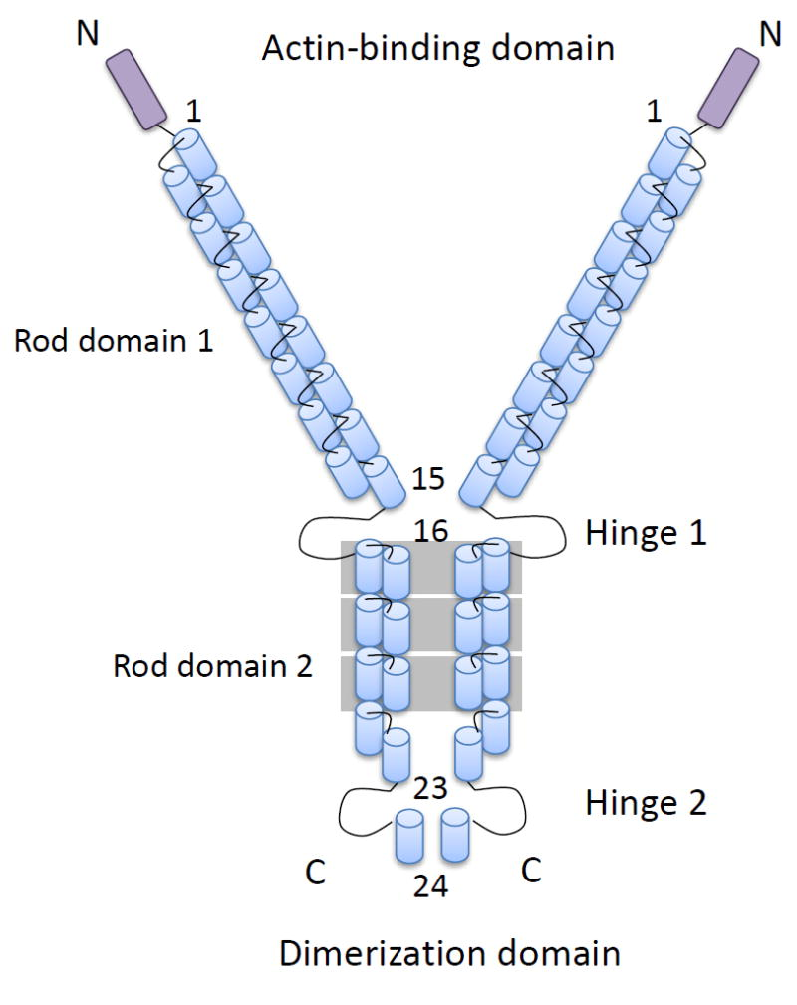
Thank you
08 / 08
Notes:
SAY
Thank you.
IMAGE CREDIT / NOT SPOKEN
Published schematic: Razinia Z, Makela T, Ylanne J, Calderwood DA. Filamins in mechanosensing and signaling (2012), Figure 1. https://pmc.ncbi.nlm.nih.gov/articles/PMC5508560/ Original source image retained with reversible PowerPoint colour formatting for the dark slide. No shapes, labels or scientific details redrawn; schematic, not an atomic structure or photograph.
QUESTIONS & ANSWERS / NOT TIMED
1. What is Filamin-A, and what does it do?
An intracellular actin-binding protein that organises actin microfilaments into networks and connects them to other proteins, including membrane receptors.
2. How large is one Filamin-A chain?
About 280 kDa, with 2,647 amino acids in the canonical human sequence. A homodimer contains two such chains, approximately 560 kDa in total.
3. What are the main parts of each chain?
An N-terminal actin-binding domain followed by 24 immunoglobulin-like repeats, with two flexible hinge regions. Repeat 24 contributes to joining the two chains.
4. What does homodimer mean, and why is it useful here?
Two identical protein chains associate. This gives Filamin-A two actin-binding ends, so one molecule can connect two different actin filaments.
5. Does immunoglobulin-like mean Filamin-A is an antibody?
No. It describes the shape of a folded domain, not an antibody function. These beta-sheet-rich repeats provide structural units and protein-binding surfaces.
6. Which proteins are its binding partners?
Examples include actin, integrin cytoplasmic tails and other receptor-associated or signalling proteins. Different regions of Filamin-A recognise different partners.
7. How does Filamin-A turn force into a biochemical response?
Force can change its conformation. In the repeat 20-21 region, this can expose a binding site on repeat 21 and allow a new partner to bind. The amino-acid sequence does not change.
8. Does Filamin-A use ATP to move actin?
It is not an ATP-driven motor like myosin. Its role here is binding, organising and transmitting force through the actin network.
9. What are its two roles in platelets?
It helps link receptors to actin in mature platelets and contributes to platelet production and stability. In experimental mice, its absence caused premature release of large, fragile platelets from megakaryocytes.
10. What medical condition illustrates its importance?
Certain FLNA variants cause periventricular nodular heterotopia: clusters of neurons remain beside the brain's ventricles instead of reaching their normal cortical position. Seizures can occur.
11. What did the 2026 study show, and is it a treatment?
In cultured epithelial cells, Filamin-A-dependent force sensing helped normal cells respond to transformed neighbours through ETV4/5 and PRKG2. The normal cells enlarged and helped extrude the transformed cells. This is experimental tissue-defence research, not an established cancer treatment.

