Slide 1
Interferons in Antiviral Defence
Hans Vilu
01 / 13
Notes:
Interferons in antiviral defence.

Slide 2
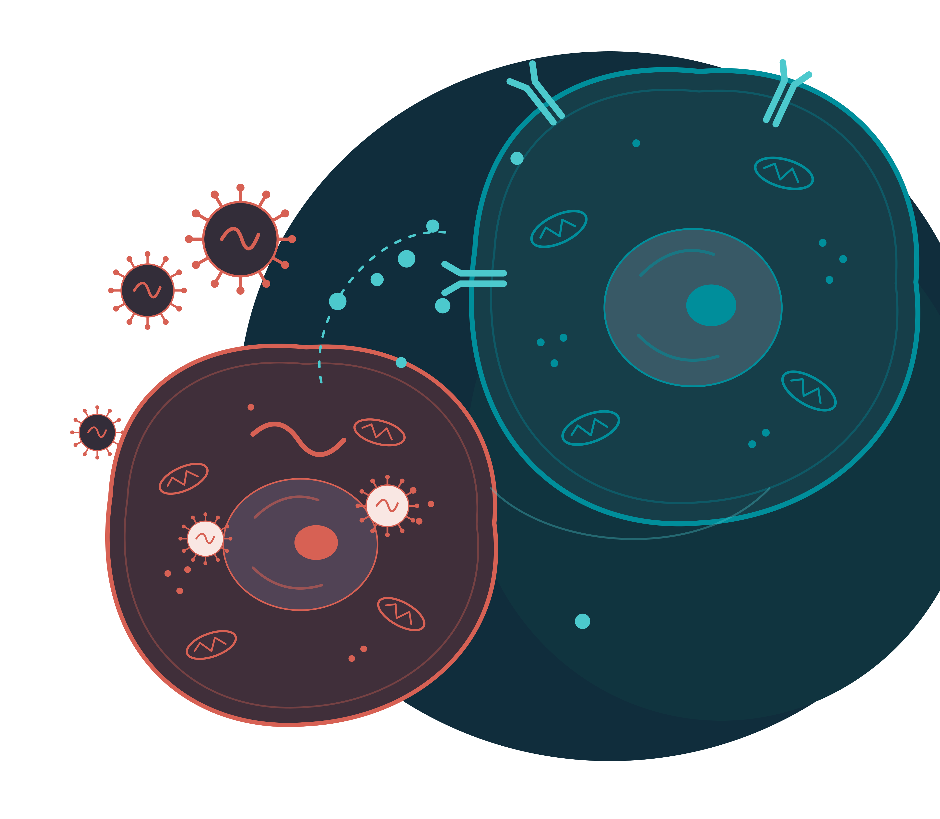
OVERVIEW
Interferons: an early warning
A virus enters a cell.
The cell sends a warning.
Nearby cells prepare.
Interferons = signalling proteins
An early defence that buys time for adaptive immunity.
02 / 13
Notes:
Interferons are cytokines central to antiviral defence. They warn cells to prepare antiviral proteins and help coordinate immune cells. They do not neutralise viruses directly: they change how our cells respond to infection.
-----
EXTRA EXPLANATION / NOT SPOKEN
The signal is not the defence itself
What does interferon actually do?
It binds a receptor and changes gene expression in the responding cell. The cell then produces proteins that make viral replication more difficult. The interferon is the instruction; those proteins carry out much of the antiviral work.
What does an antiviral state mean?
A cell has activated a set of defences that makes it harder for a virus to use it. This is not a physical shield, and it does not guarantee that the cell cannot become infected.
Why is this useful early?
A warning can reach nearby cells before the virus does. They can prepare while the more specific adaptive response is still developing.

Slide 3

A NEIGHBOURHOOD WARNING
Analogy
Houses = cells
Type I interferon = alarm
Virus = burglar
Neighbours prepare
NK cells = patrol
Uses host ribosomes to make proteins
Restrict viral replication
Check targets before killing
03 / 13
Notes:
Imagine a neighbourhood of houses, each representing an airway epithelial cell. Each house contains a workshop: the cell's protein-making machinery. A virus enters and hijacks that workshop.
The infected cell sends a type I interferon alarm. Nearby cells prepare defences that make their machinery harder to exploit.
It also primes the NK-cell patrol, but the alarm is not a kill order. NK cells check activating and inhibitory signals before killing a target.
BACKGROUND / NOT SPOKEN
Airway epithelial cells: ordinary cells lining the nose, windpipe and bronchi, including ciliated cells. Infected and nearby uninfected cells can respond to interferon. This is the clearest neighbourhood example for a respiratory virus; type I and type III interferons can both contribute.
Skin keratinocytes: the main cells of the epidermis. They can participate in local interferon responses during viral infection; skin is another possible neighbourhood.
Fibroblasts: connective-tissue cells beneath epithelial surfaces that make extracellular matrix. They can respond to type I interferon and develop antiviral defences. They are not immune patrol cells.
Intestinal epithelial cells: cells lining the gut. They are another useful neighbourhood example, but type III interferon is particularly important here; do not imply that every tissue relies equally on type I interferon.
The workshop means host-cell machinery, especially ribosomes: viruses need the cell's ribosomes to translate viral messenger RNA into proteins. They also use cellular energy and building materials. Some viruses encode their own genome-copying enzymes, so not every replication step is performed by a host enzyme.
Interferon is protective through signalling, not by directly attacking free virus particles. Responding cells make antiviral proteins, and NK cells assess activating and inhibitory target-cell signals before killing. The warning can act on the producing cell as well as its neighbours.
-----
EXTRA EXPLANATION / NOT SPOKEN
Keep each part of the analogy separate
House versus workshop
The house is the whole cell. The workshop is machinery inside it, especially ribosomes. A virus brings genetic instructions and relies on the cell to make viral proteins; it does not turn the whole cell into a different kind of object.
What do the neighbours do?
They respond to interferon by preparing antiviral proteins. These can interfere with protein production or promote RNA breakdown. The alarm does not simply lock a door and prevent all viral entry.
Why does the patrol check another house?
The tissue can contain more than one infected or stressed cell. NK cells assess each potential target using activating and inhibitory signals; they do not necessarily travel straight to the cell that released interferon. Hearing an alarm alone does not mark a cell for killing.

Slide 4
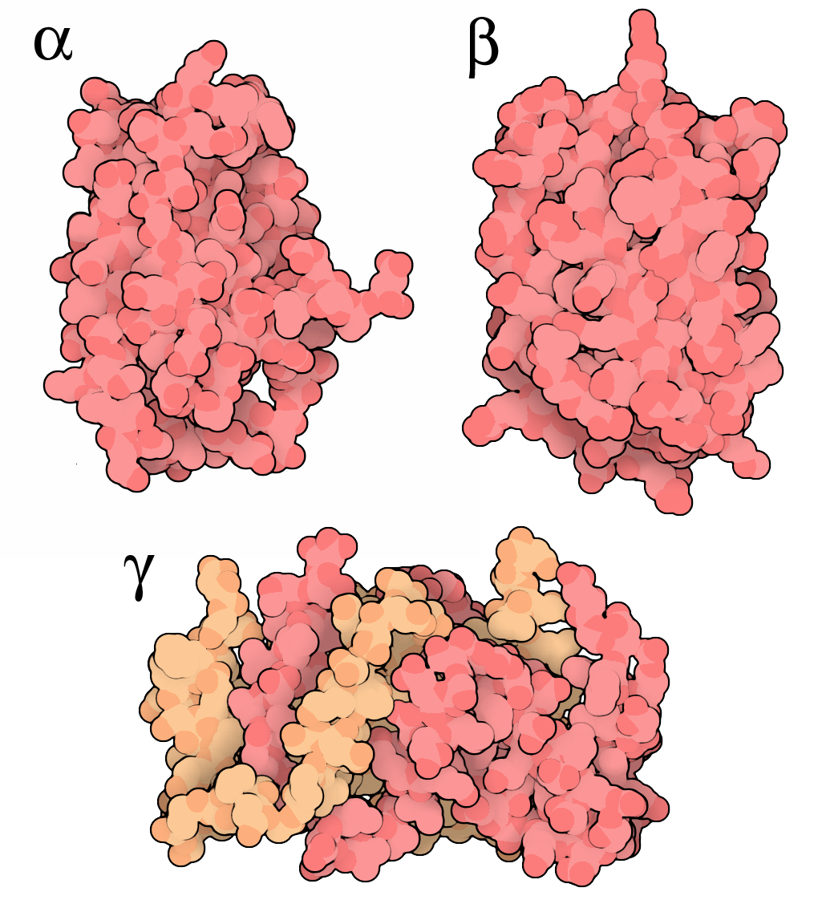
MOLECULAR VIEW
What interferons look like
IFN-alpha
IFN-beta
IFN-gamma
Type I / one chain
Type I / one chain
Type II / two chains
Source: David S. Goodsell / RCSB PDB-101 | Structure-based illustrations
04 / 13
Notes:
Alpha and beta are each a single protein chain. Gamma functions as a dimer: two chains, shown in different colours. These are distinct proteins, not stages of one molecule. Lambda is not shown here.
-----
EXTRA EXPLANATION / NOT SPOKEN
What the different shapes tell you
One chain or two?
Alpha and beta are each shown as one folded polypeptide chain. Functional gamma consists of two chains associated as a dimer. Two differently coloured parts do not mean two different interferon types.
Why does shape matter?
A protein's folded surface determines which receptor surfaces it can bind. These structures help explain molecular recognition; they are not pictures of interferon physically attacking a virus.
What are we actually looking at?
These are structure-based molecular illustrations, not microscope photographs. Their colours are visual labels, not the natural colours of the proteins. Lambda is not included in this image.
IMAGE CREDIT / NOT SPOKEN: David S. Goodsell / RCSB PDB-101, CC BY 4.0. https://pdb101.rcsb.org/motm/128. License: https://creativecommons.org/licenses/by/4.0/. Display adjusted for the dark theme; original artwork preserved.

Slide 5
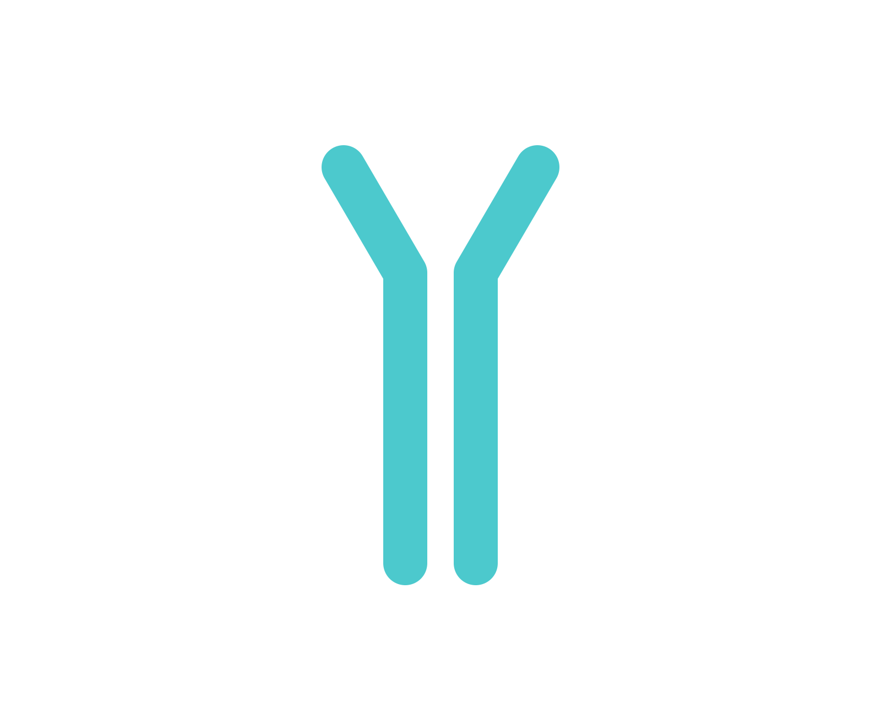
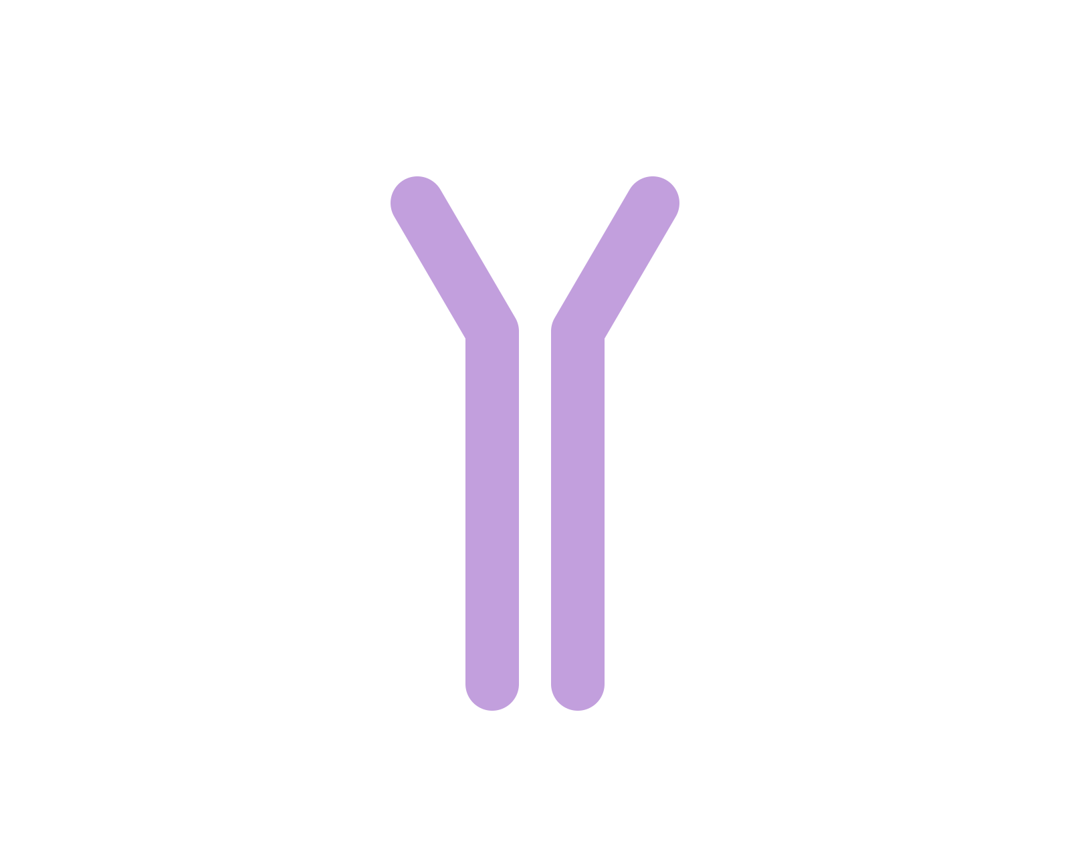
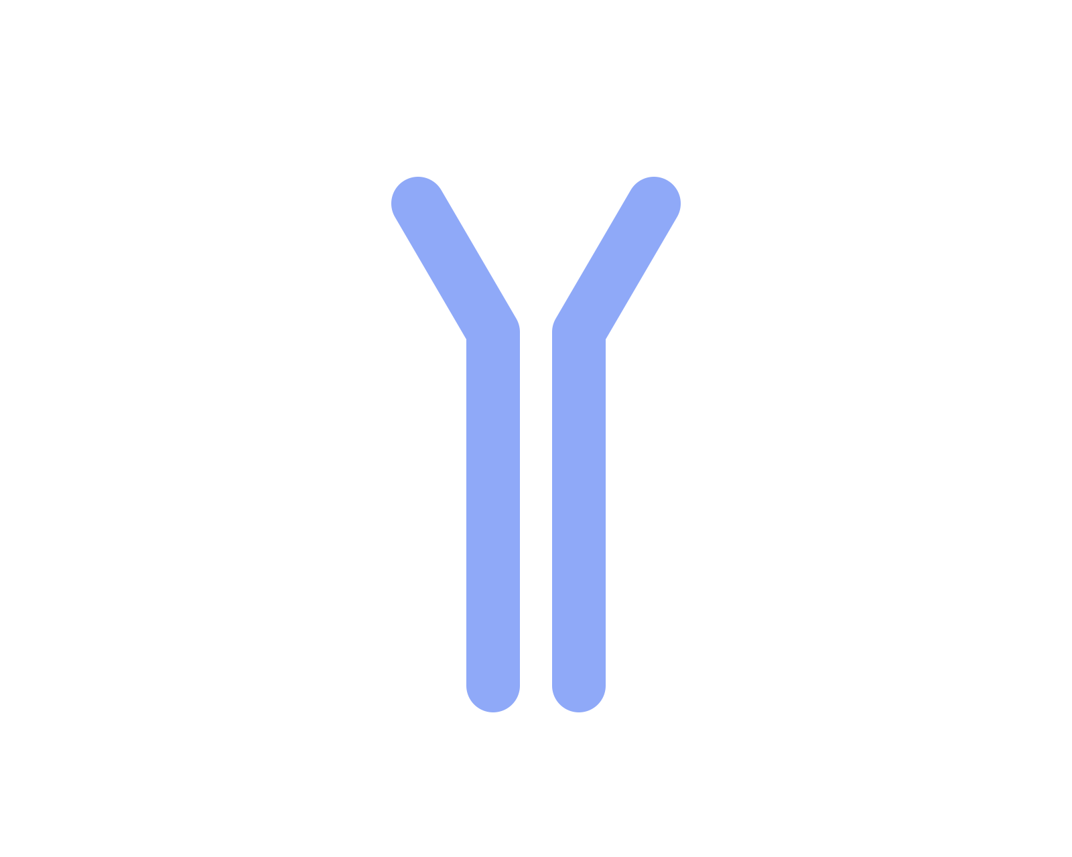
THREE TYPES
Three types, different main roles
Type I
Type II
Type III
Mainly alpha + beta
Gamma
Lambda 1-4
Many cell types; pDCs
are strong alpha producers
Produced by NK cells
and activated T cells
Acts mainly on
epithelial barriers
Broad antiviral
protection
Cellular immunity;
macrophage activation
Barrier-focused
antiviral protection
21 distinct human interferons: 16 type I + 1 type II + 4 type III.
05 / 13
Notes:
There are 21 distinct human interferon proteins across three receptor-defined types. Type I includes alpha and beta, produced by many cells; plasmacytoid dendritic cells are particularly strong alpha producers.
Type II, gamma, comes mainly from NK and activated T cells and activates macrophages. Type III, lambda, acts mainly at epithelial barriers.
BACKGROUND / NOT SPOKEN
The total of 21 counts distinct mature human interferon proteins: 16 type I, one type II and four type III. It is not a count of genes or of all interferons across animal species.
Type I: 12 distinct alpha proteins plus beta, epsilon, kappa and omega. The 13 alpha genes include IFNA1 and IFNA13, which encode the same mature protein. This is why gene-based lists may give 17 type I interferons and 22 overall.
Type II is gamma. Type III comprises lambda1, lambda2, lambda3 and lambda4; not everyone has a functional IFNL4 allele. The count describes the human repertoire, not what every person or cell produces.
Human interferon count and receptor classification: https://www.frontiersin.org/journals/immunology/articles/10.3389/fimmu.2020.606489/full
Discovery of IFNL4: https://www.nature.com/articles/ng.2521
-----
EXTRA EXPLANATION / NOT SPOKEN
Three kinds of message, not three stages
Type I: a broad antiviral warning
Alpha and beta are the main examples in this talk. Many cell types can respond to them, and plasmacytoid dendritic cells are particularly strong alpha producers. Other type I members also exist; alpha and beta are not the entire group.
Type II: strengthen immune-cell activity
Gamma is mainly produced by NK cells and activated T cells. A major effect is to activate macrophages so they become better at killing microbes they have engulfed. Gamma is still a signal, not the patrol cell itself.
Type III: an alarm focused on barriers
Lambda 1-4 induces an antiviral programme similar to type I. Its receptor is more restricted in distribution, so responses are especially important in epithelial tissues such as the airway and intestine.
What does the total of 21 count?
Distinct mature human interferon proteins: 16 type I, one type II and four type III. This is not a gene count. The detailed counting convention is retained in the backup notes.

Slide 6
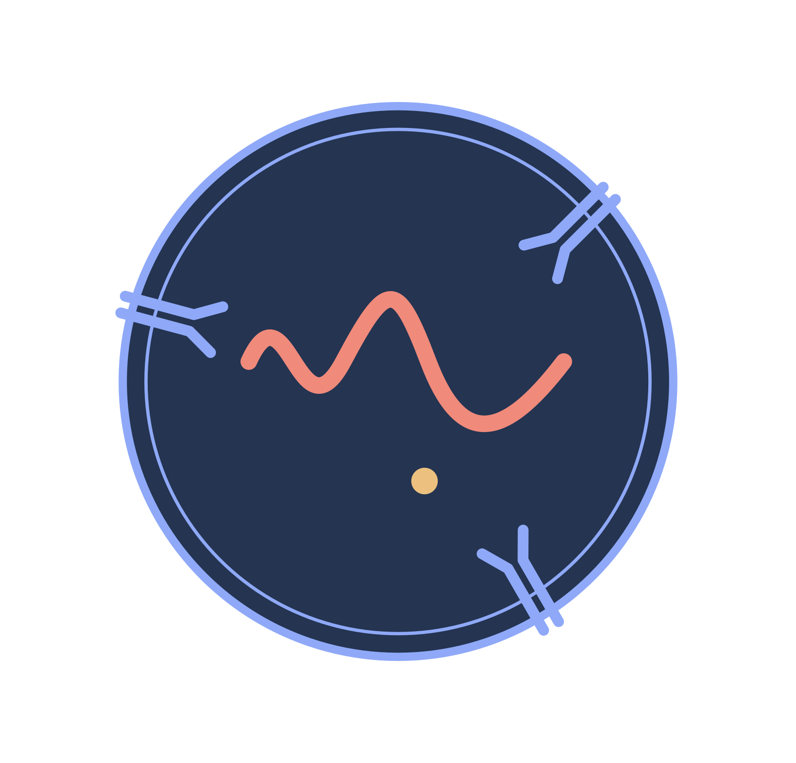
DETECT
Detect the viral material
Inside endosomes
Signals converge
Toll-like receptors
recognise viral RNA or DNA
IRF3 / IRF7
Switch on interferon genes
In the cytoplasm
Viral RNA
RIG-I / MDA5
MAVS
Interferon release
Recognition leads to interferon production and release.
06 / 13
Notes:
First, a cell must detect infection. Toll-like receptors in endosomes, and RNA sensors such as RIG-I and MDA5 in the cytoplasm, recognise viral genetic material.
They pass the signal through intracellular relays to transcription factors such as IRF3 and IRF7. These help switch on interferon genes, so the cell makes and releases the warning. This is interferon production, not yet the response to it.
-----
EXTRA EXPLANATION / NOT SPOKEN
From viral material to an interferon warning
1. A sensor recognises a molecular pattern
The sensor does not recognise a virus by its overall appearance. It binds particular nucleic-acid features, such as certain double-stranded RNA structures, in a particular cellular compartment.
2. A relay carries the information
RIG-I and MDA5 signal through MAVS. MAVS then helps activate downstream signalling proteins. The original viral RNA does not have to travel to the nucleus and switch on interferon genes itself. Toll-like receptors use different adaptors, not MAVS.
3. Transcription factors act on genes
IRF3 and IRF7 help regulate interferon gene transcription in the nucleus. They are gene-control proteins, not forms of interferon. The cell subsequently translates the interferon messenger RNA and secretes the resulting protein.
The boundary between slides 6 and 7
Slide 6: a cell detects viral material and produces interferon. Slide 7: a cell detects that interferon through its surface receptor and prepares defences. The same cell can participate in both processes.

Slide 7
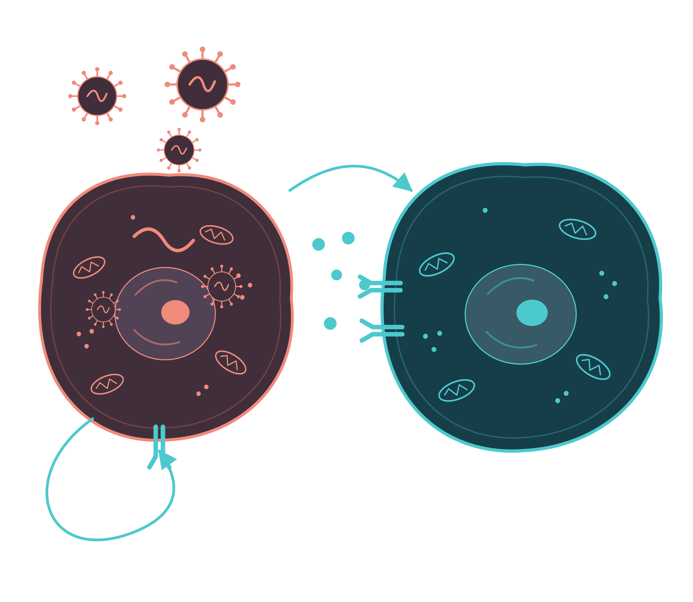
SIGNAL
Turn the warning into a response
Interferon receptor
Receives the warning
JAK-STAT
Carries the signal to the nucleus
Antiviral genes
Produce protective proteins
Autocrine / same cell
Paracrine / nearby cells
07 / 13
Notes:
Interferon binds a receptor on the cell surface. This activates JAK-STAT signalling inside the cell. Activated STAT-containing complexes enter the nucleus and switch on interferon-stimulated genes, causing the cell to produce antiviral proteins.
The warning can act on the same cell, called autocrine signalling, or on nearby cells, called paracrine signalling.
-----
EXTRA EXPLANATION / NOT SPOKEN
How does the signal actually travel?
It is a relay, not one molecule making the entire journey
Interferon stays outside the cell while the message is passed through different proteins inside it. Some steps involve binding or phosphorylation; other steps involve proteins physically moving to a new location.
Follow the message through the cell
Outside the cell: Interferon moves through extracellular fluid and binds its receptor on the cell surface.
At the membrane: Binding brings the receptor chains into an active arrangement. JAK enzymes attached to their intracellular parts become activated. Interferon does not cross the membrane with the signal.
In the cytoplasm: JAKs phosphorylate STAT proteins. In the canonical type I pathway, STAT1 and STAT2 associate with IRF9 to form the ISGF3 complex.
Through a nuclear pore: Nuclear-transport proteins help activated STAT-containing complexes pass through the nuclear envelope into the nucleus. This part involves actual movement of proteins.
Inside the nucleus: The complexes bind regulatory DNA sequences and promote transcription of interferon-stimulated genes. The genes stay in place; their activity changes.
How do STATs get through the nuclear envelope?
The envelope contains nuclear pore complexes: selective gateways, not permanent holes admitting everything. Transport proteins called importins recognise appropriate features of the activated STAT complex and help carry it through a pore. You do not need the importin subtype names for the spoken explanation.
What happens after genes are switched on?
The cell transcribes those genes into messenger RNA. The RNA leaves the nucleus and ribosomes translate it into proteins. Those proteins, including PKR and OAS, help produce the antiviral state.
One distinction worth remembering
The interferon molecule does not travel from outside the cell to its DNA. Information is relayed; STAT-containing complexes are among the molecules that physically enter the nucleus.

Slide 8
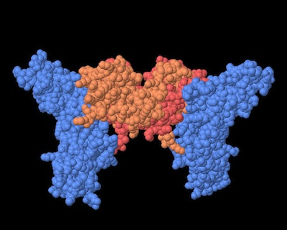
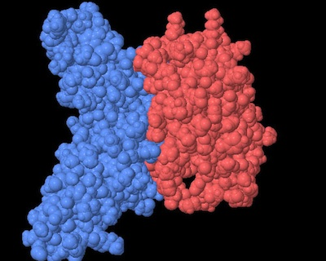
MOLECULAR VIEW / SIGNAL
A signal needs a matching receptor
Gamma + receptor-binding chains
Alpha + one receptor chain
Source: RCSB PDB-101 | Structures 1FG9 and 2KZ1
08 / 13
Notes:
Here, the orange and red parts are interferons; the blue parts are host receptor components. On the left, gamma binds receptor chains on both sides. On the right, alpha is shown with one receptor chain. These are partial binding complexes, not complete membrane-spanning receptors.
-----
EXTRA EXPLANATION / NOT SPOKEN
Reading the pictures, step by step
What are the coloured blobs?
These are magnified 3D models of proteins, not pictures of whole cells. The small spheres represent atoms. The colours have been added to distinguish the proteins; they are not their natural colours.
Left picture: interferon gamma
The orange and pink-red parts intertwined in the middle are interferon gamma. They are its two protein chains, together forming one functional dimer. The blue pieces on either side are the outside, interferon-binding parts of the cell's receptor. They are not extra interferons and are not virus proteins.
Right picture: interferon alpha
The coral-red part on the right is interferon alpha. The elongated blue part on the left is one receptor component, called IFNAR2. Here alpha is a single protein chain. The picture shows it touching the receptor at the surfaces where they bind.
What is the receptor doing?
A receptor is the cell's receiver for a particular signal. In a living cell, the complete receptor complex sits in the cell membrane, with a binding region facing outside. Interferon arrives outside the cell and attaches to a compatible receptor: the message has reached its receiver.
What happens after they bind?
Binding helps organise the receptor complex so that associated proteins inside the cell can start signalling. The JAK-STAT pathway then changes gene expression. Alpha promotes an antiviral programme; gamma strongly activates immune functions, especially in macrophages. Interferon does not have to enter the nucleus and switch genes on itself.
What is missing from these pictures?
The cell membrane, the inside of the cell and the full set of receptor components are not shown. Alpha also needs another receptor chain, IFNAR1, absent from this image. Gamma likewise needs additional signalling receptor chains. These images show the binding contact, not the entire working signalling system.
The simple meaning
On this slide, orange/red = the interferon message, and blue = the cell's receiver. Their contact starts a response inside the cell; this is not a picture of a virus being killed.
IMAGE CREDIT / NOT SPOKEN: RCSB PDB-101, CC BY 4.0 / 1FG9 and 2KZ1. https://pdb101.rcsb.org/motm/128. License: https://creativecommons.org/licenses/by/4.0/. Display adjusted for the dark theme; original artwork preserved.

Slide 9
PROTECT
Make replication more difficult
PKR
OAS + RNase L
Less protein synthesis
RNA breakdown
Viral double-stranded RNA activates PKR
Viral double-stranded RNA activates OAS
PKR phosphorylates eIF2-alpha
OAS makes 2-5A
Translation initiation slows
RNase L is activated and cleaves RNA
An antiviral state restricts replication, but can also affect the host cell.
09 / 13
Notes:
Two examples show what the warning prepares. PKR reduces protein synthesis: viral double-stranded RNA activates it, and it phosphorylates eIF2-alpha, making translation harder to start.
OAS works differently. When activated by double-stranded RNA, it makes 2-5A, which activates RNase L to cut RNA. So one pathway restricts protein production; the other promotes RNA breakdown. Interferon prepares these defences, while viral RNA helps activate them.
Neither mechanism is perfectly selective for the virus, so host protein synthesis and RNA can also be affected.
-----
EXTRA EXPLANATION / NOT SPOKEN
Preparing a defence is different from activating it
Why are two signals involved?
Interferon increases the availability of defensive proteins. Viral double-stranded RNA can then activate PKR and OAS. An uninfected neighbour can therefore prepare before it encounters the viral trigger.
PKR: interfere with starting protein synthesis
PKR is a kinase: it adds phosphate groups to proteins. Its important target here is eIF2-alpha, part of the machinery that initiates translation. Phosphorylation interferes with efficient initiation, so the cell makes fewer proteins. PKR does not directly chop up a virus.
OAS: make the signal that activates the RNA cutter
OAS uses ATP to make 2-5A. The 2-5A activates RNase L, and RNase L cleaves RNA. Keep the roles separate: OAS makes the messenger; RNase L is the RNA-cutting enzyme.
Why can the cell be harmed too?
Viruses use the host's protein-making machinery, and these defences are not perfectly specific for viral RNA. Inhibiting translation and degrading RNA can therefore disrupt the host cell as well as the virus.

Slide 10
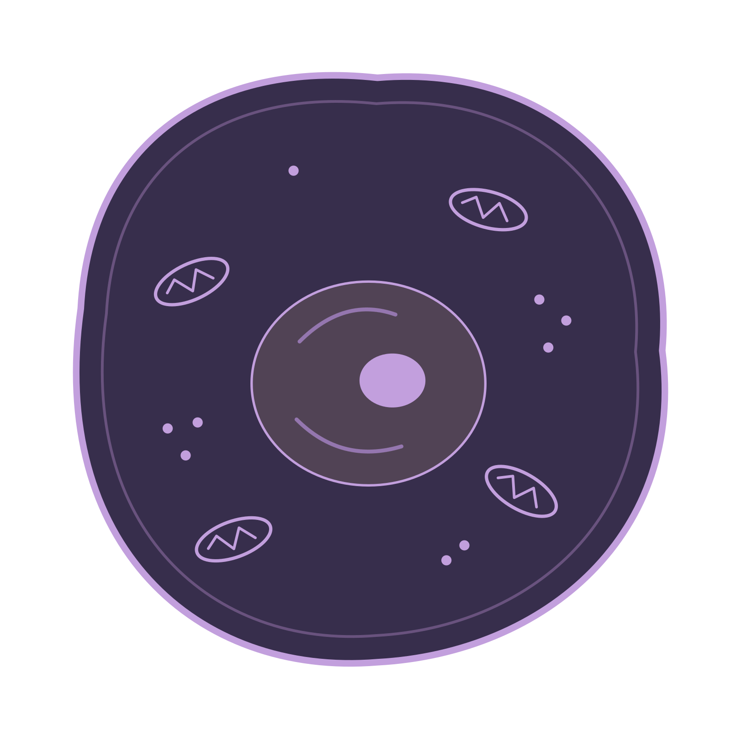
IMMUNE-CELL SUPPORT
Protection also needs immune cells
Type I: alpha + beta
Type II: gamma
Support NK cells
Early killing of infected cells
Increase MHC class I
Help CD8 T cells recognise infection
Activates macrophages
Antiviral protection inside cells + coordinated immune-cell activity.
10 / 13
Notes:
Type I interferons also enhance NK-cell responses and increase MHC class I expression. MHC I presents intracellular peptides for CD8 T-cell recognition; NK cells instead integrate activating and inhibitory target-cell signals.
Interferon gamma has a different emphasis: it activates macrophages, strengthening their ability to kill ingested microbes.
-----
EXTRA EXPLANATION / NOT SPOKEN
Three immune-cell roles that should not be mixed up
NK cells: an early target check
NK cells balance activating and inhibitory signals on a potential target. Self MHC I supplies important inhibitory signals. Type I interferon can enhance NK-cell readiness, but it does not identify a particular target or order it to be killed.
CD8 T cells: specific peptide recognition
MHC I displays peptide fragments from proteins made inside a cell. A CD8 T cell with the appropriate receptor can recognise a viral peptide displayed this way. Increasing MHC I can support this recognition; it does not mean that MHC I universally activates NK cells.
Macrophages: stronger killing of engulfed microbes
Gamma activates macrophages and improves their antimicrobial functions. The macrophage is the responding cell; gamma is the instruction that changes its behaviour.

Slide 11
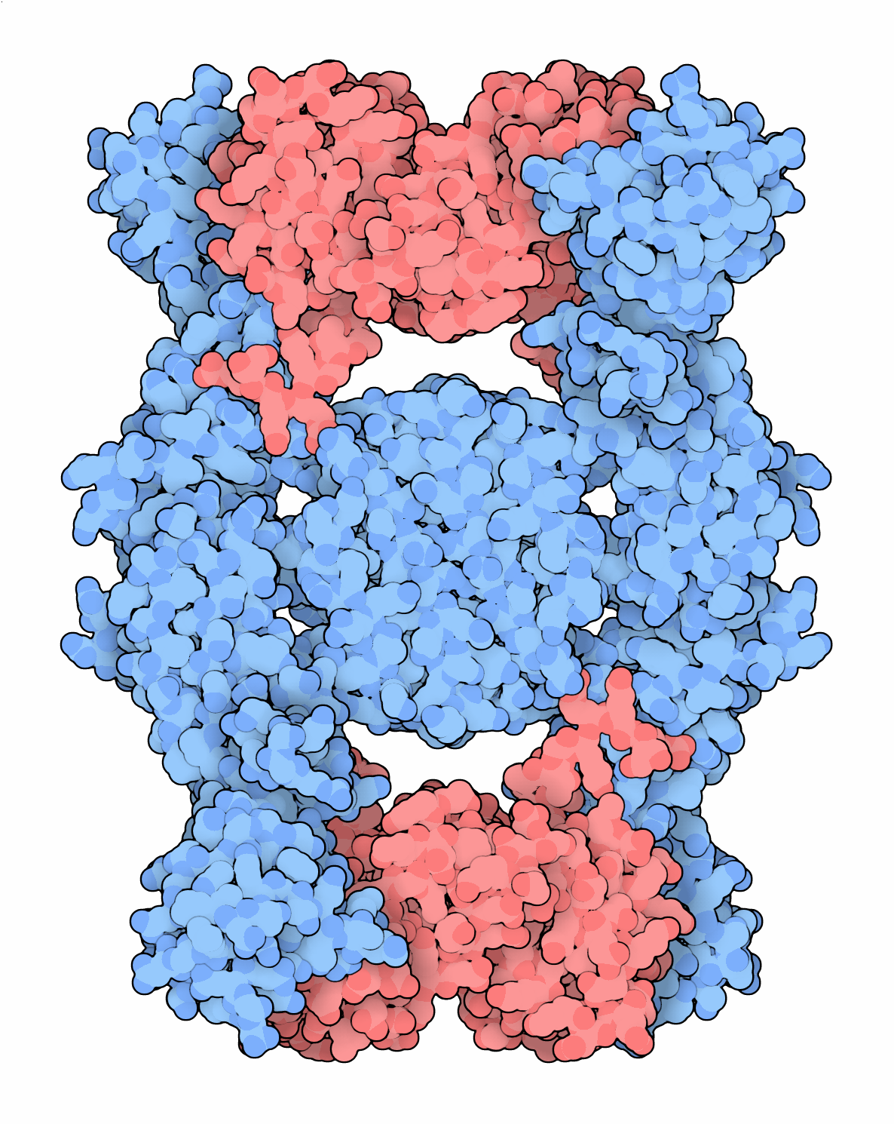
MOLECULAR VIEW / VIRAL EVASION
A virus can intercept the warning
Viral C4R
IFN-gamma
An interferon trap
The captured signal
Ectromelia virus / blocks normal receptor binding
11 / 13
Notes:
Viruses also evolve ways to block this system. This blue protein is C4R from ectromelia virus, which causes mousepox. It traps interferon gamma, shown in red, so gamma cannot reach its normal receptor. The virus is intercepting the signal.
-----
EXTRA EXPLANATION / NOT SPOKEN
The colours now represent a different interaction
What is blue this time?
C4R is a viral interferon-binding protein, not a normal human receptor. It comes from ectromelia virus, the cause of mousepox. The image does not show a whole virus particle.
What is being trapped?
The red component is interferon gamma. Binding to the viral protein prevents it from reaching its normal receptor, so the normal downstream message is blocked.
Compare this with slide 8
Slide 8 shows productive binding to host receptor components. Slide 11 shows interception by a viral protein. A protein binding interferon is not automatically a signalling receptor.
IMAGE CREDIT / NOT SPOKEN: David S. Goodsell / RCSB PDB-101, CC BY 4.0 / 3BES. https://pdb101.rcsb.org/motm/128. License: https://creativecommons.org/licenses/by/4.0/. Display adjusted for the dark theme; original artwork preserved.

Slide 12
Summary
Early + controlled
Persistent + excessive
Limits viral spread
Can injure tissue and delay repair
Cells detect
infection
Interferons
signal
Cells inhibit
viral replication
Buy time for adaptive immunity.
12 / 13
Notes:
In summary, cells detect infection, interferons transmit the warning, and responding cells restrict viral replication. This early response buys time for adaptive immunity. It must also be controlled, because persistent signalling can damage tissue.
-----
EXTRA EXPLANATION / NOT SPOKEN
Connect the whole story
Detect, signal, respond
Viral sensing triggers interferon production. Interferon binds a receptor on a responding cell. That cell changes gene expression, restricts viral replication and coordinates help from immune cells.
Why not keep the response at maximum?
A defence that suppresses protein synthesis, degrades RNA and stimulates immune activity has costs. Persistent or excessive signalling can contribute to tissue injury. The benefit depends on timing, location and control, not just on producing more interferon.

Slide 13
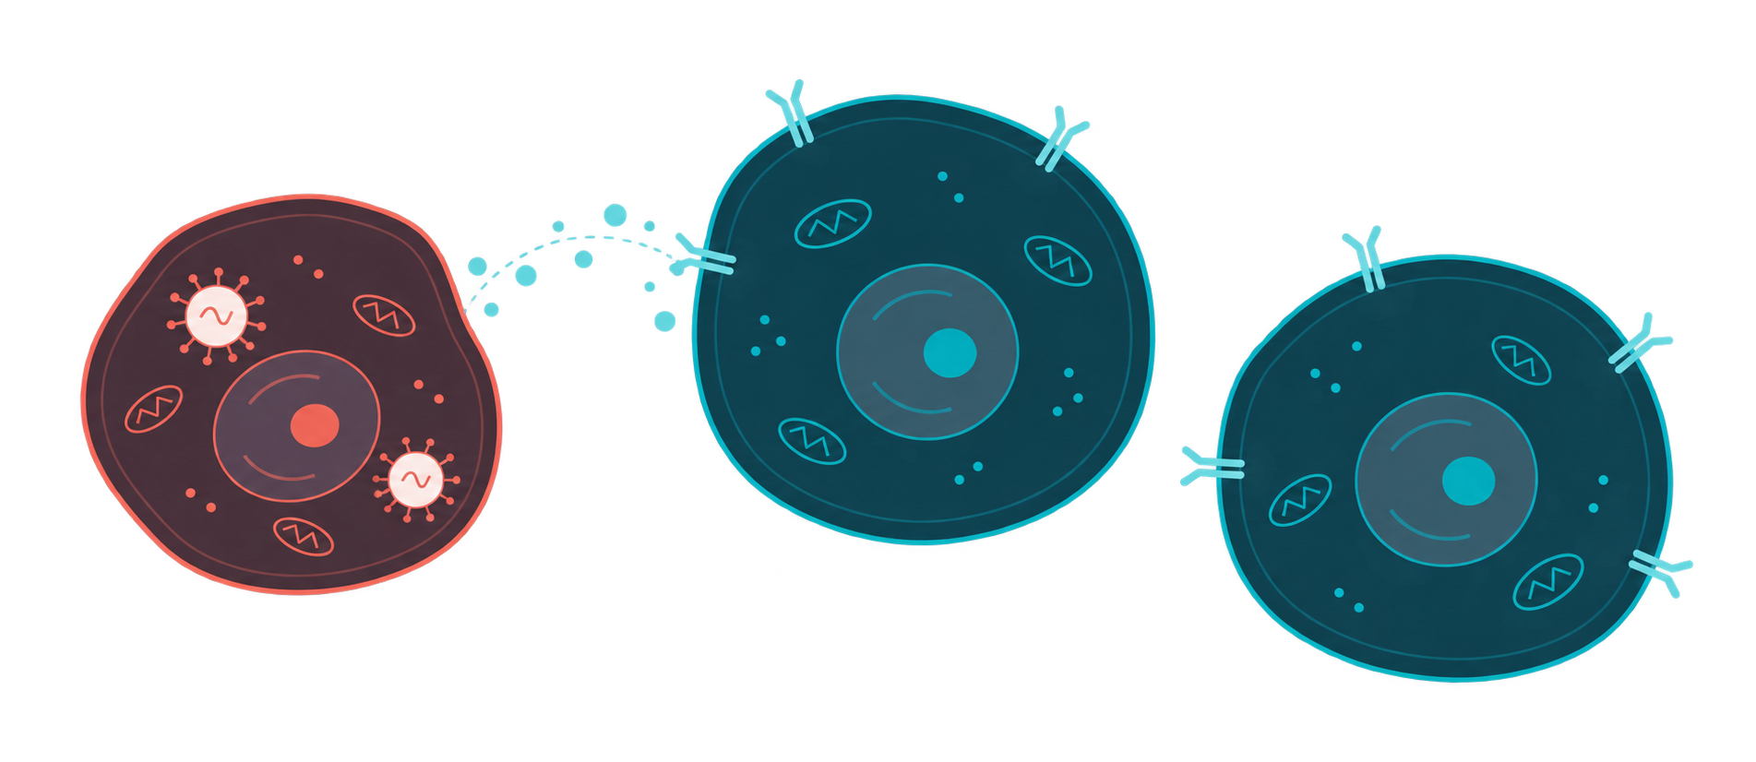
Thank you
13 / 13
Notes:
Thank you.

